Slide 1

Microcontroller programming

Slide 2

Introduction
In this presentation:
We talk about what we are going to learn in this module
We talk about how the learning will take place
We introduce the E-blocks hardware
We introduce the E-blocks software: Flowcode
We introduce the worksheet system
We talk about assessment and grading

Slide 3
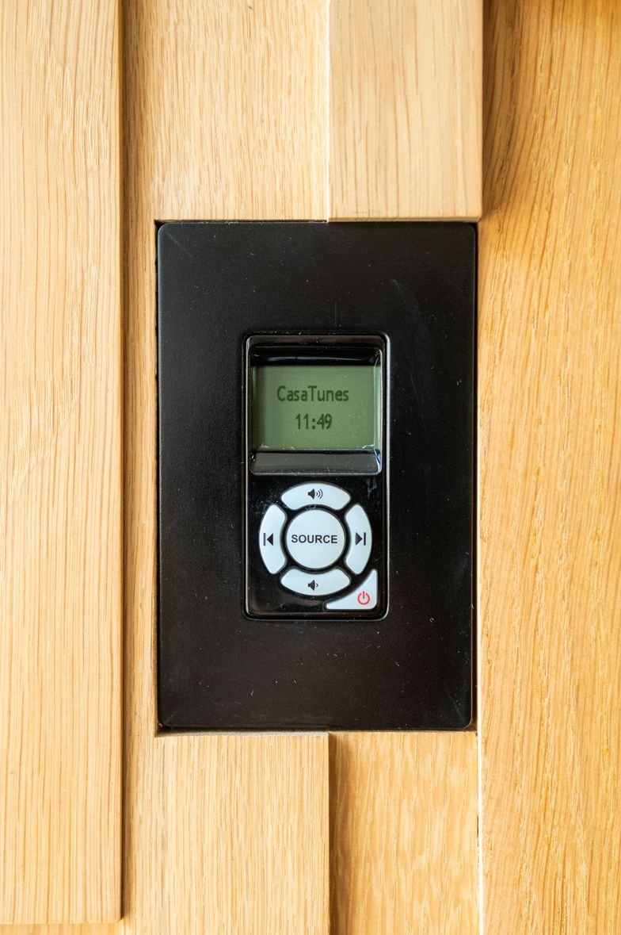
What we are going to learn
How long:
Option 1 - 60 guided hour module:
60 hours of classes
30 hours of homework
Option 2 - 120 guided hour module:
120 hours of classes
60 hours of homework
We are going to learn how to create modern electronics systems. That means
Microcontroller programming
Microcontroller hardware
Microcontroller system design – the electronics part
When you have finished this module you will be able to design complex electronic systems.

Slide 4
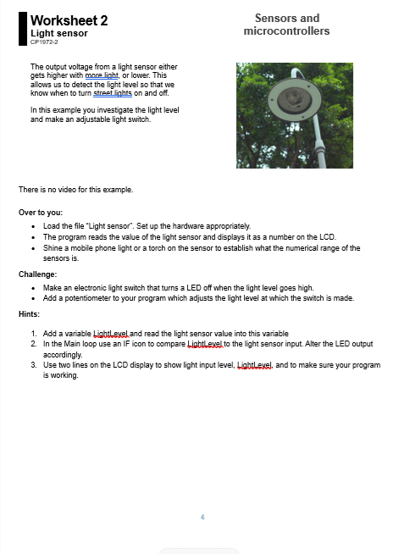
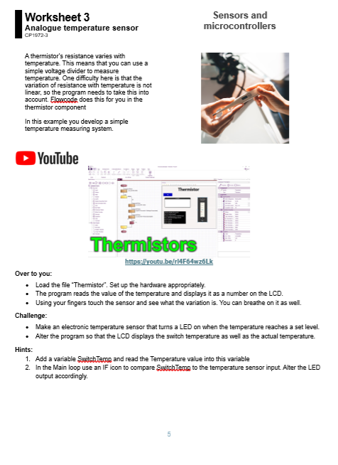

Microcontroller curriculum
Full courses are provided – designed around Flowcode
Around 50 hours of work
Flowcode example files included
Integration with YouTube videos.

Slide 5
Introduction to microcontrollers
This beginner’s curriculum frames the work for students wanting to program microcontrollers for the first time. The core curriculum consists of a number worksheets covering topics from flashing your first LED through to the sue of timer and pin interrupts. The worksheets are accompanied by a series of videos available free of charge on the Flowcode YouTube site.
Microcontroller programming in flowcharts using Flowcode
Hardware: LEDs, Switches, LCD displays, graphical displays, 7-segment displays
Software: inputs, outputs, delays, decisions (IF, CASE) connection points, variables, types, strings, loops, hardware macro functions, software macro functions, calculations, comments, timer interrupts, pin interrupts, A/D, D/A, binary, hexadecimal
More than 20 videos free on YouTube
Accompanying example files on the Flowcode Wiki
15 hours of learning

Slide 6
Sensors and microcontrollers
This curriculum allows students to explore the use of analogue and digital sensors.
Analogue sensors: potentiometer, light sensor, thermistor
Digital sensors : temperature/humidity, g force
Graphing sensor data on LCD displays
I2C and SPI buses.
Free videos on YouTube
Examples on the Flowcode Wiki
8 hours of learning for core worksheets

Slide 7
Motors and microcontrollers
This curriculum allows students to explore the control of small motors using microcontrollers using the E-blocks compatible Actuators board. The worksheets are accompanied by videos on Youtube. Requires a logic analyser.
Motor control
DC motor full bridge
Motor speed measurement with optical feedback
Servo motor control
Stepper motor control
Free videos on YouTube
Examples on the Flowcode Wiki
7 hours of learning

Slide 8
PC interfacing
This curriculum allows students to interface embedded projects with other computer-based systems: a Windows PC and a mobile phone. Students use Flowcode Embedded, and Flowcode PC Developer software.
USB to PC communications
PC software development – Flowcode PC Developer
Free videos on YouTube
Examples on the Flowcode Wiki
10 hours of learning

Slide 9




How we are going to learn
Lectures:
Very few – this is a practical module
Practical work:
Close to 60 hours
Homework:
30 hours
Tests:
All practical

Slide 10
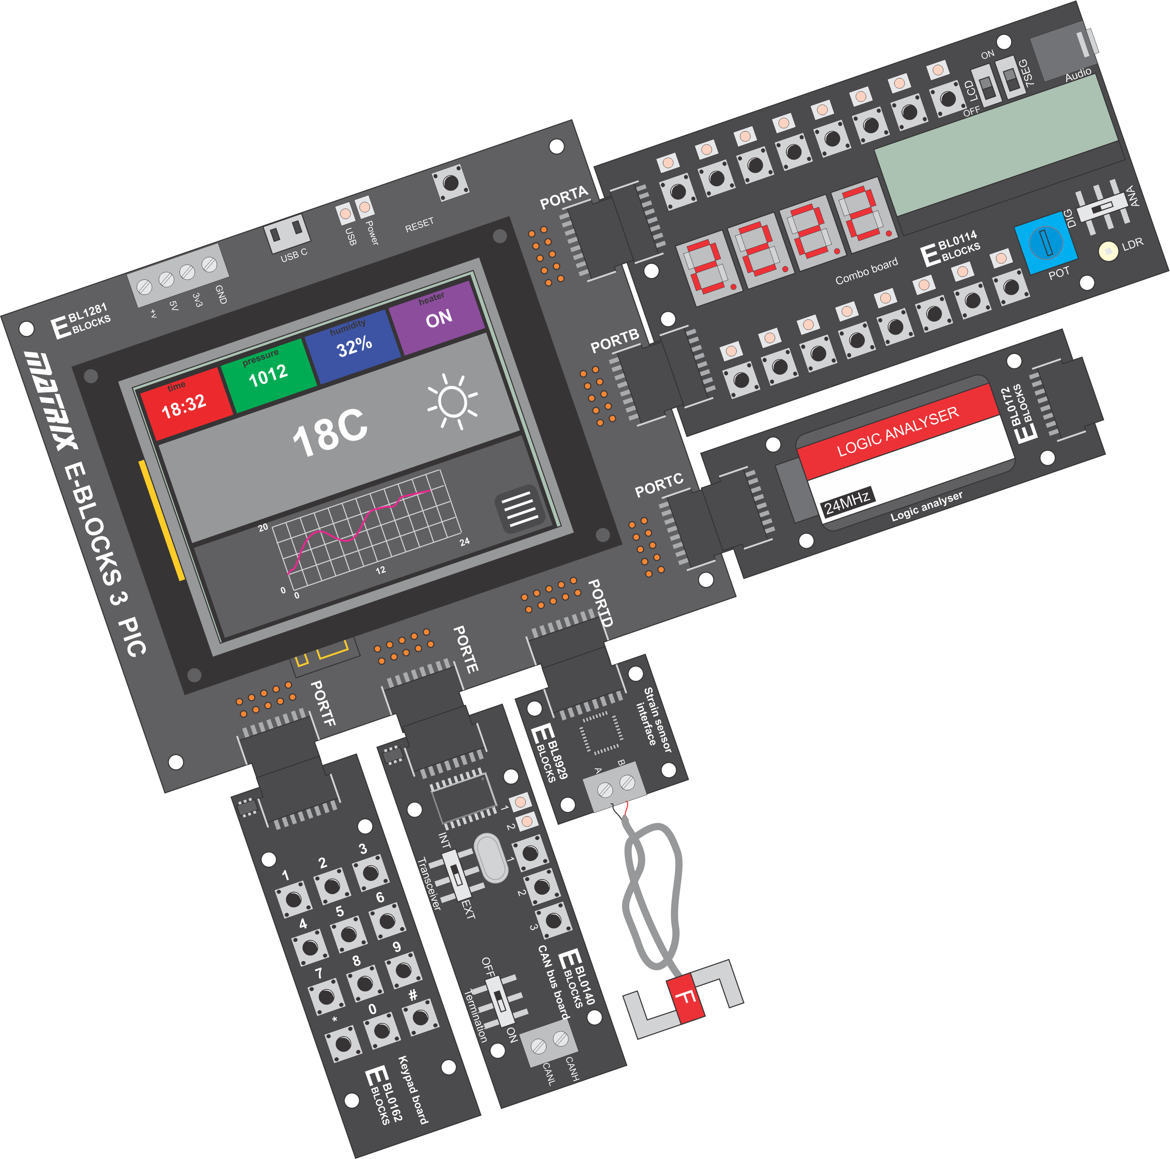
Hardware
Modular ‘plug and play’ hardware development system
Rapid assembly of multiple electronic systems to practice on
Includes 320 x 480 capacitive touchscreen display
Includes SD card, WiFi, and Bluetooth modules
Serial debugging
Large selection of peripherals

Slide 11
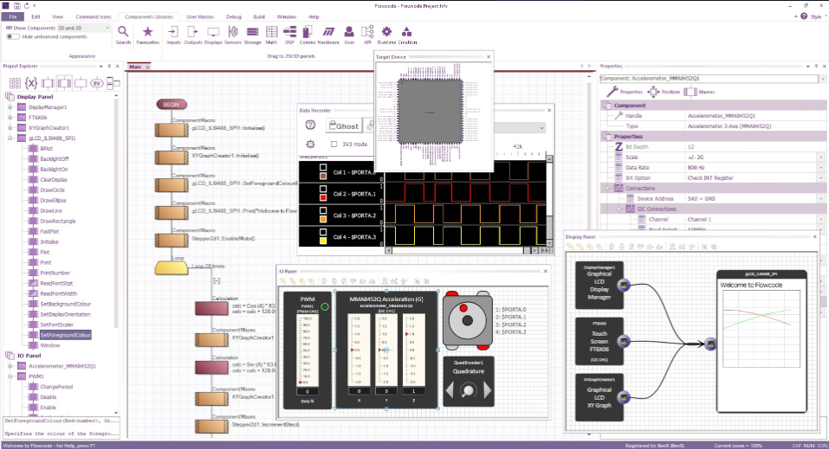
Software – Flowcode V11
Program in Flowcharts, Blocks, Script or C
Software and hardware libraries built in
Simulation built in
In Circuit Debugging with hardware

Slide 12
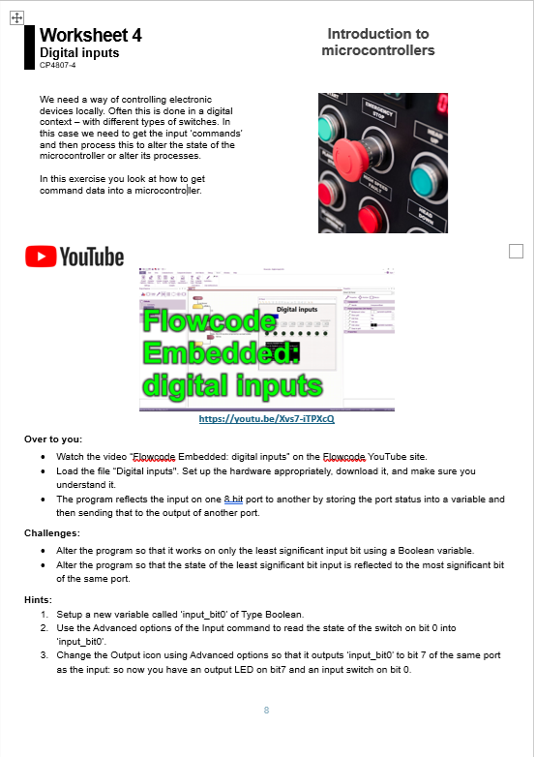
Curriculum
In general the way this works is:
You load a worksheet
Watch an introduction video
Load an example in Flowcode
Follow the instructions on the worksheet to complete the task
Sometimes you will watch the video on your own, sometimes we will watch it at the start of the practical session together.

Slide 13
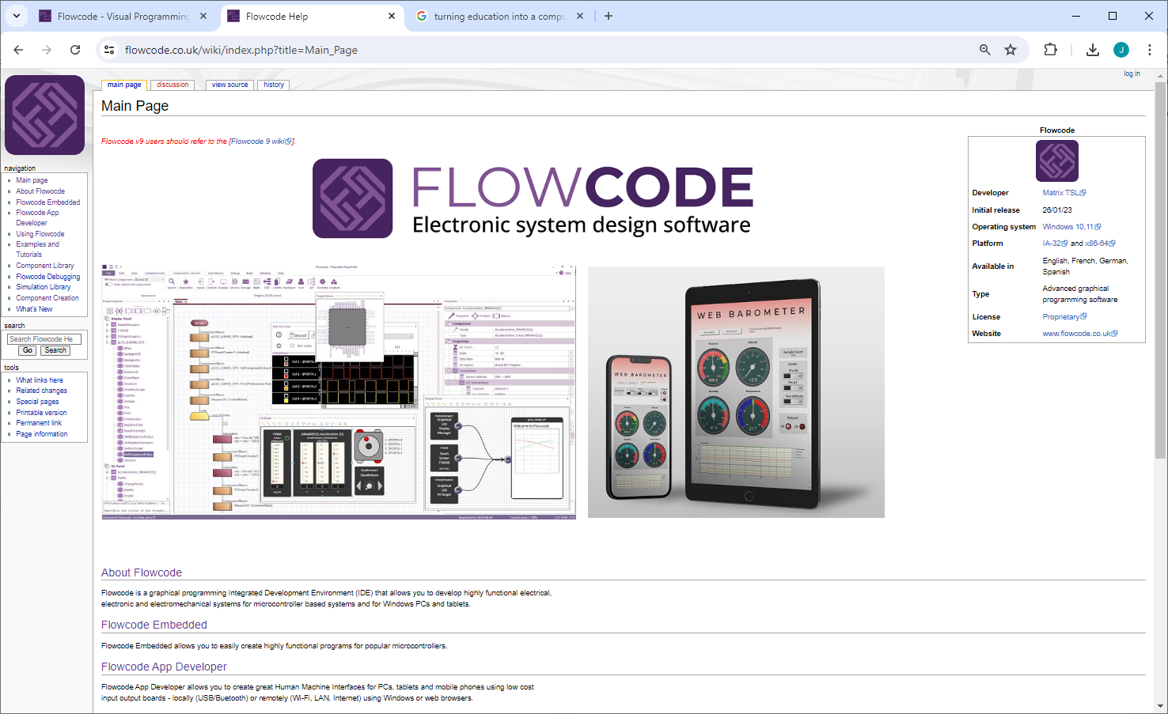
Wiki
There is a full Wiki for Flowcode with hundreds of examples here:
https://www.flowcode.co.uk/wiki/index.php?title=Main_Page

Slide 14
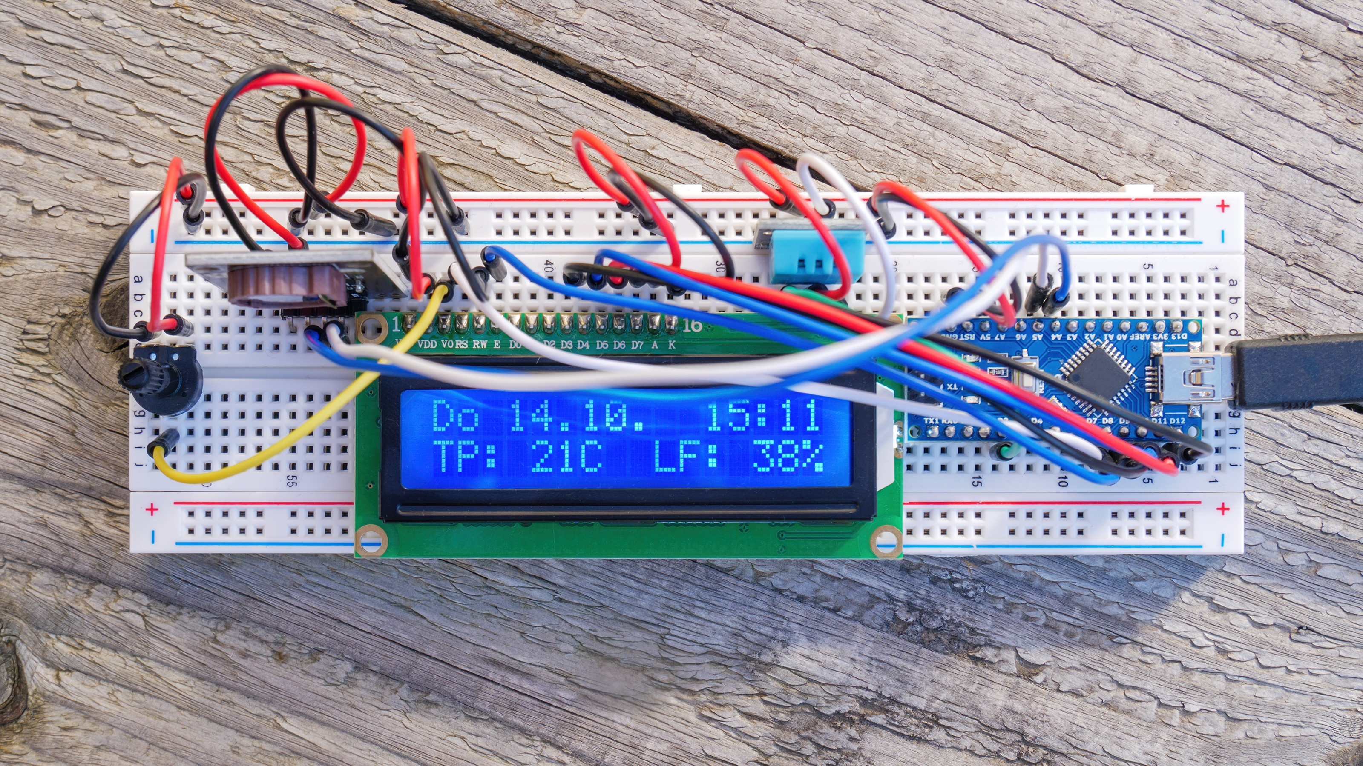
Homework
You can work using Flowcode on your computer at home
There is a free copy of Flowcode which is very functional. www.flowcode.co.uk
You can get a 1 year full license if you give your teacher your email address
You can use simulation only
You can buy a cheap target like Arduino and use a breadboard.

Slide 15
Questions

Slide 17



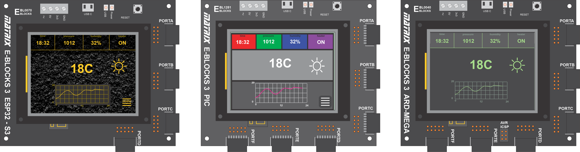
Upstream boards
ESP32S3 32 bit microcontroller
Compatible with Flowcode, Arduino and Espressif tools
Great for web enabled projects
PIC16F18877 8 bit device
Compatible with Flowcode and MPLAB IDE
Easiest for learners
Arduino / AT 2650 8 bit device
Compatible with Flowcode, and Arduino IDE
Huge online libraries of code

Slide 18
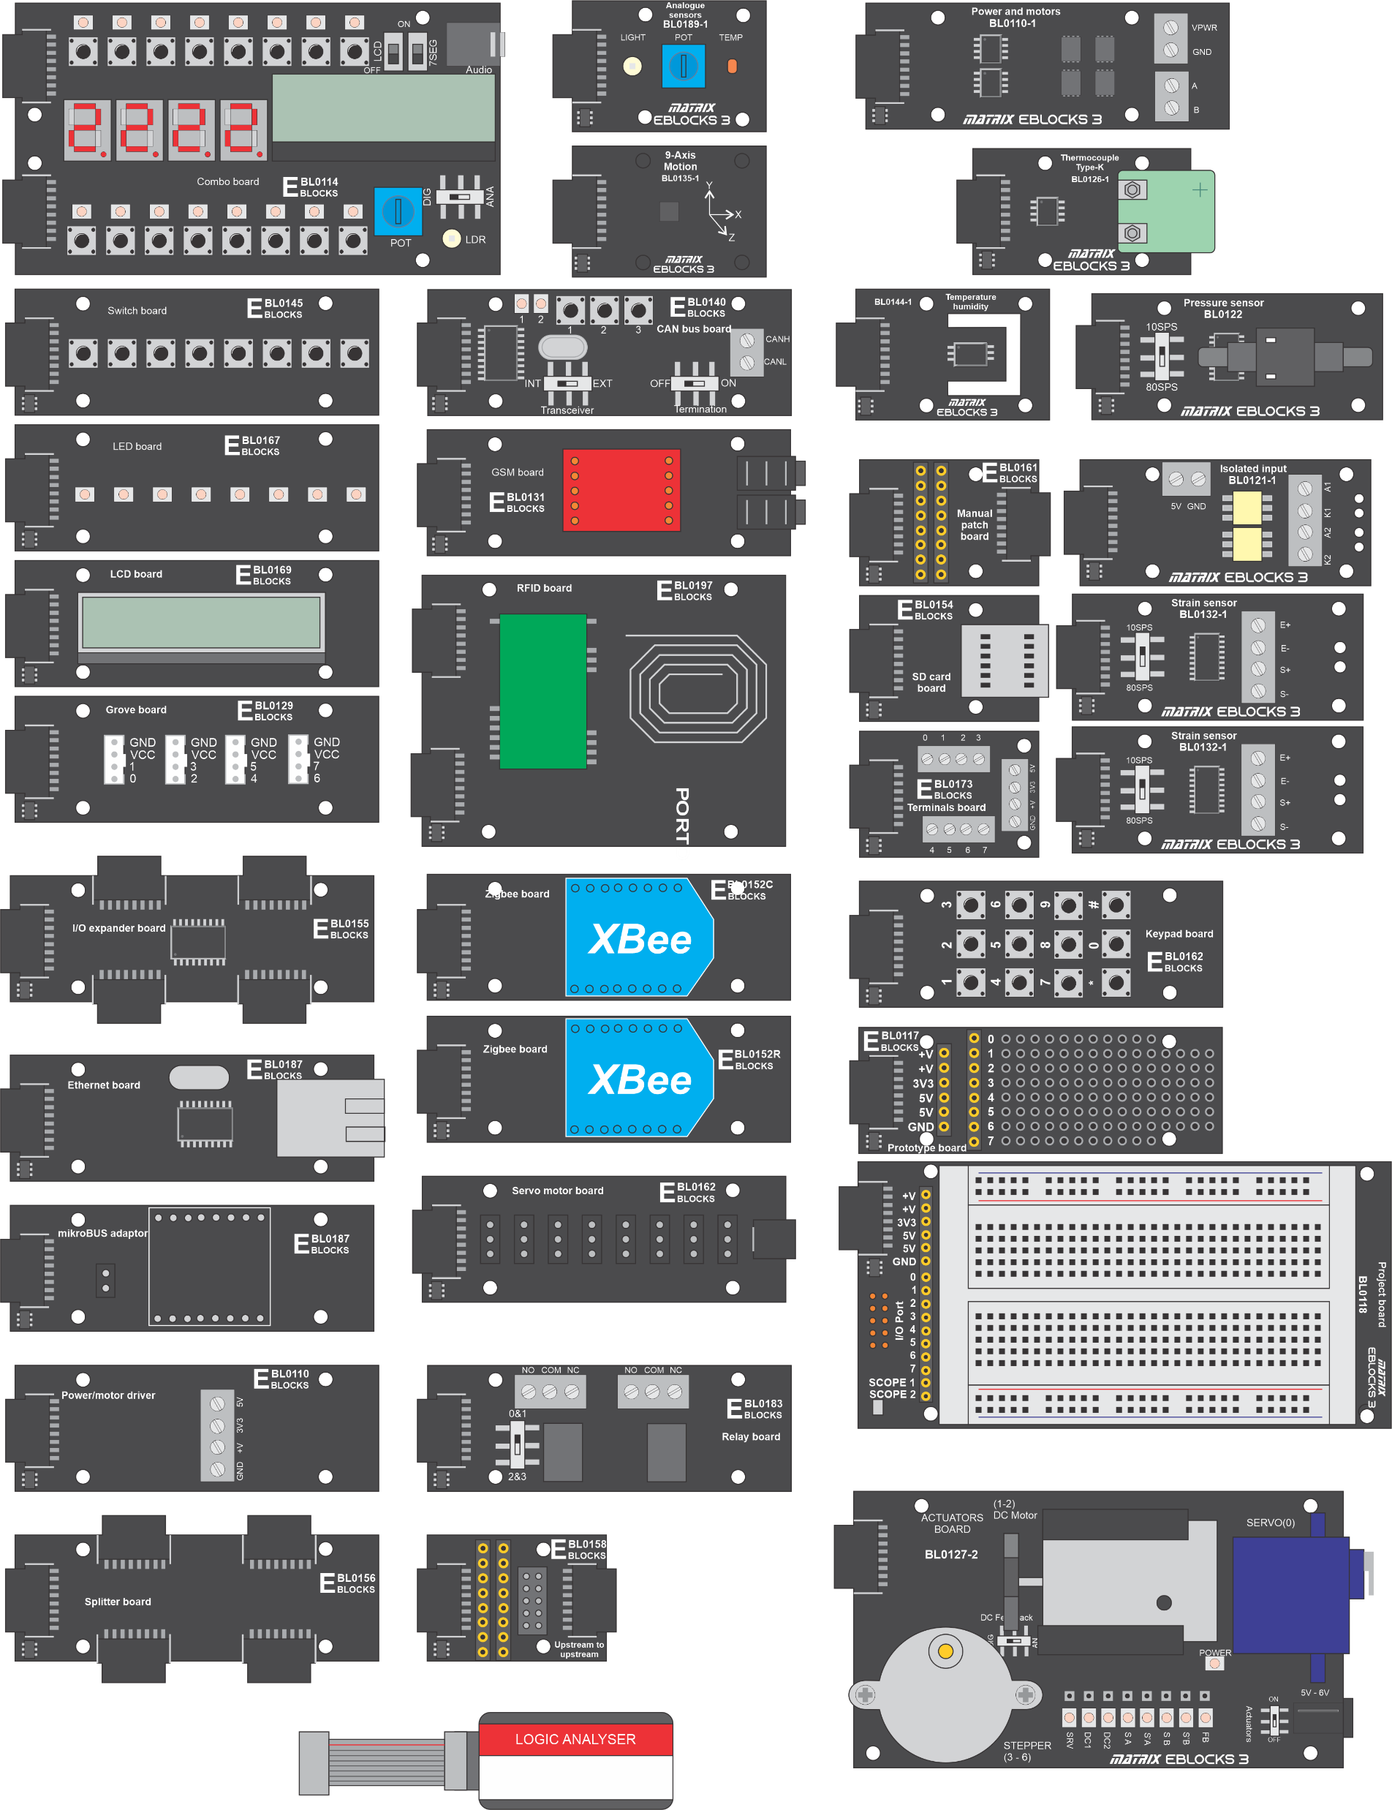
Downstream boards
Good range of boards and sensors
Compatibility with Grove and Mikroe expands to thousands of add-ons

Slide 19
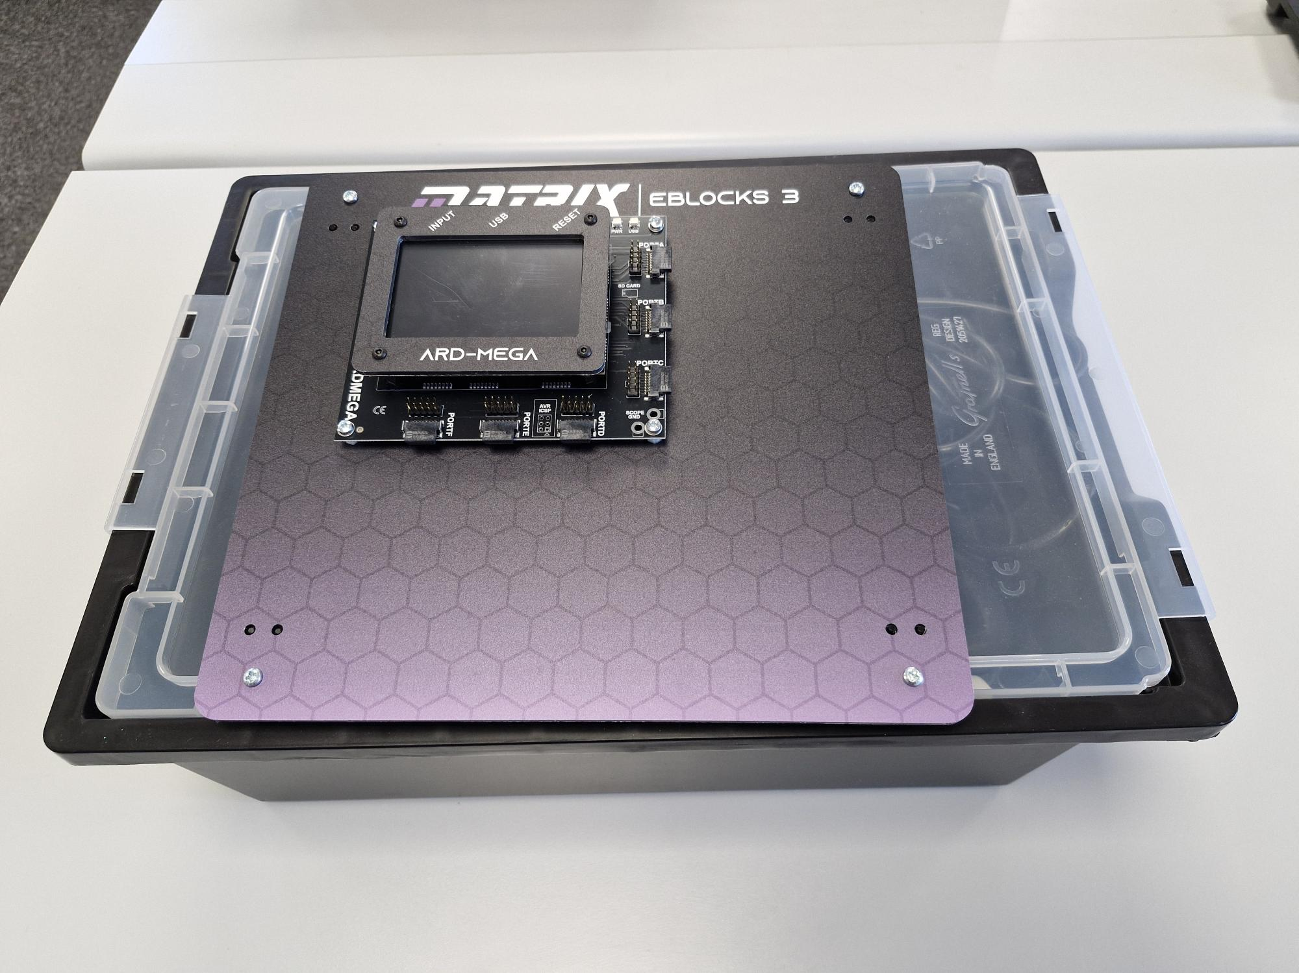
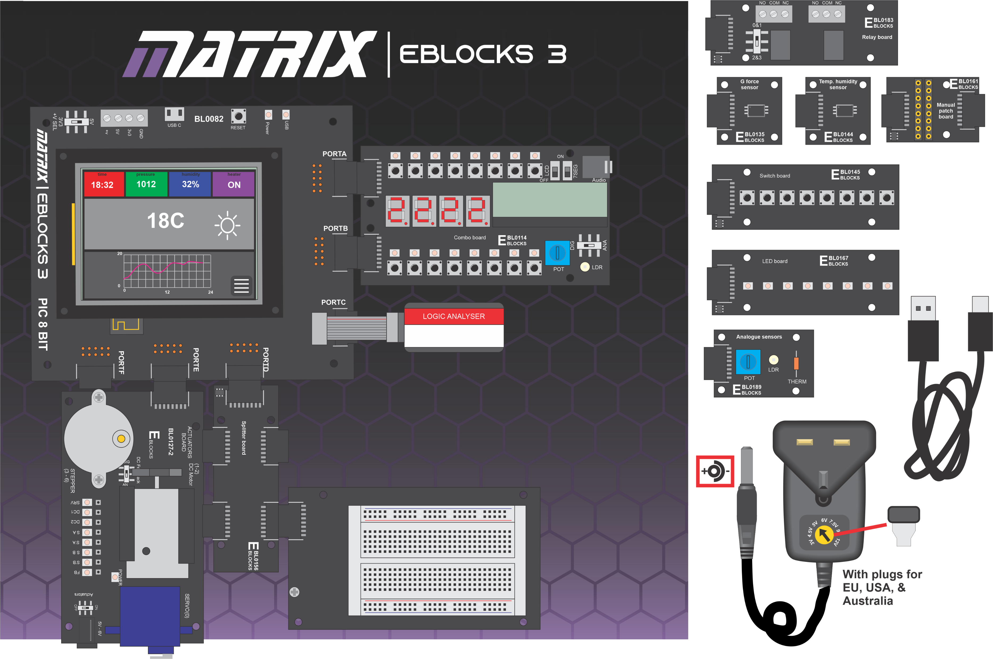
Kit contents
Your kits include:
E-blocks III development centres include
One of:
 | BL0082 PIC board and panel
 | BL3797 Arduino board and panel
 | BL0070 ESP32 board and panel
Downstream boards:
BL0114 | Combo board
BL0127 | Actuators panel
BL0145 | Switch x 8
BL0167 | LED x 8
BL0156 | Splitter
BL0118 | Prototype board with protoblock
BL0183 | Relay board
Sensor boards:
BL0135 | E-blocks III 9 axis motion sensor
BL0144 | E-blocks III temperature humidity sensor
BL0189 | Analogue sensor board
Accessories:
HP2666 | power supply
COM4822 | USB 2.0 lead
BL0172 | Logic analyser

Slide 20
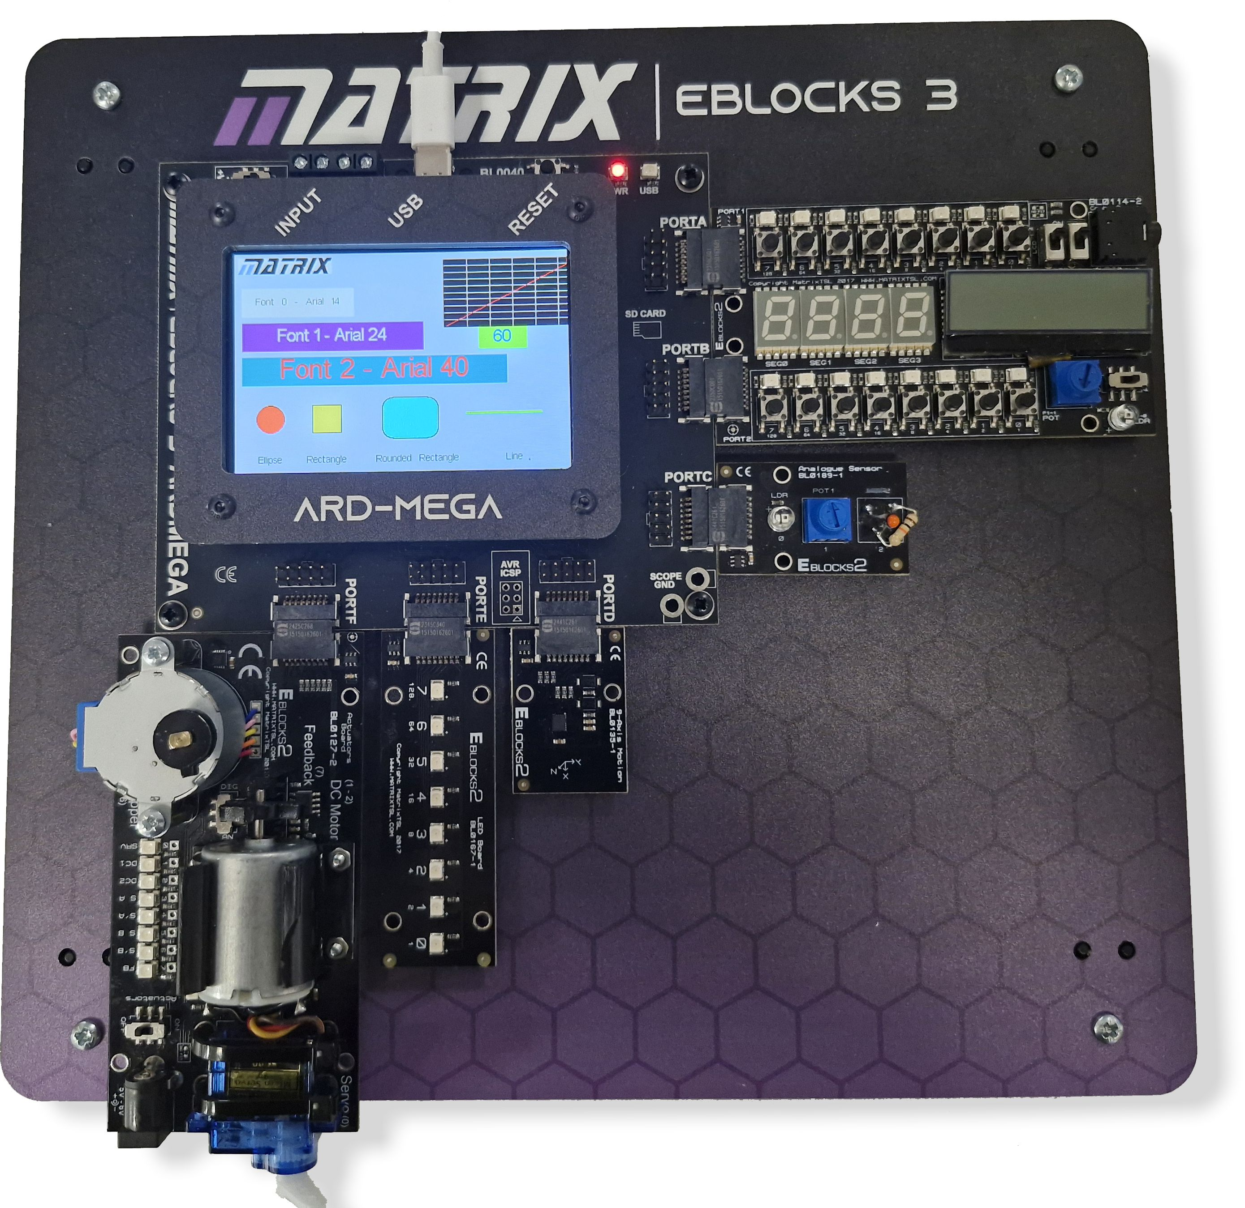
E-blocks platform
All kits are supplied with the Upstream board bolted to a rugged platform
Downstream boards can be easily changed
Kits are supplied with standard tray and accessories
Boards simply plug in and out
The Actuators panel needs a separate 5V power supply which is in the equipment tray
One set per student – programming is an individual task

Slide 21
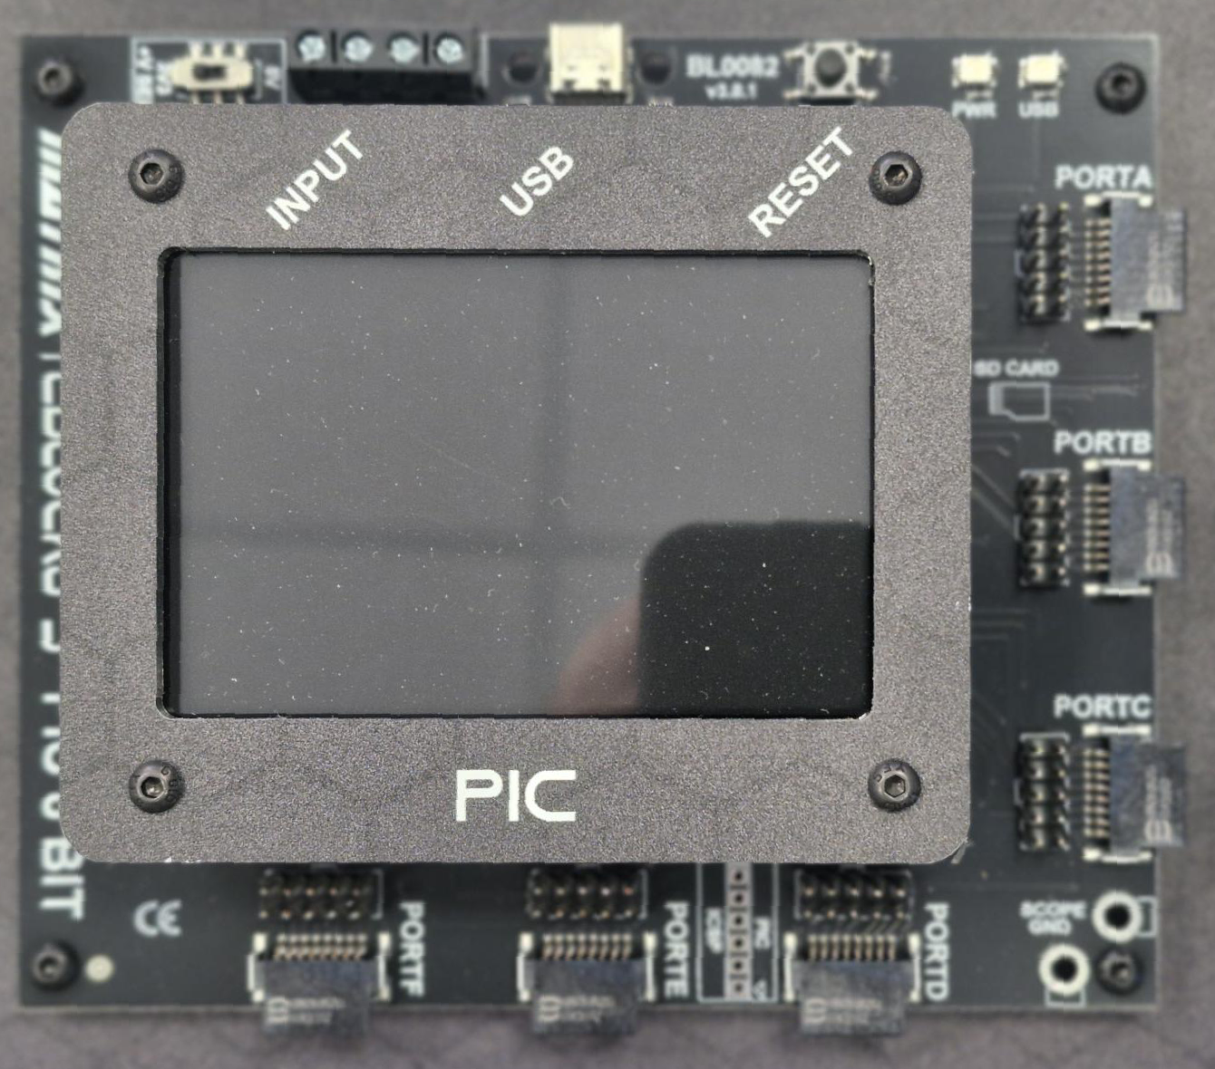
Hardware details
USB C connection: USB powered (except actuators board) 5V or 3V3
PIC, Arduino Mega and ESP32 variants available.
Compatible with:
Flowcode
Ardunio tool chain
Microchip Integrated Development Environment
Espressif IDE
Up to 6 x 8 bit ports: 48 connections
Uses 14 way quick snap connectors:
8 bits, power, ground, and management signals
Integrated 420 x 380 pixel colour touch screen
Integrated Wi-Fi and Bluetooth
IDC connectors for each port
Auto ID for downstream boards – saves configuration issues
In-Circuit debug for all software platforms

Slide 22
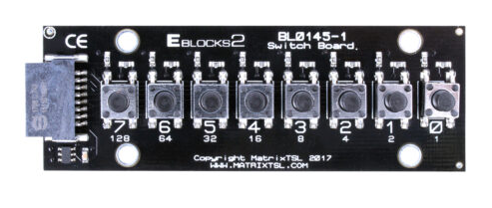
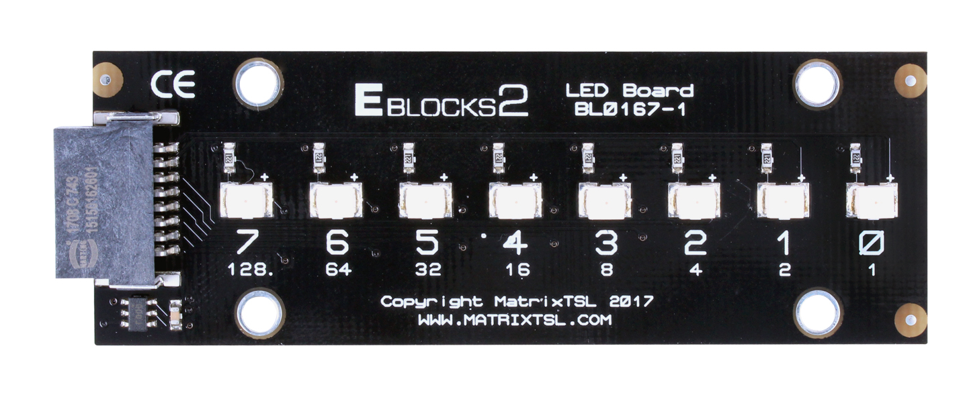
Hardware details
Switch board:
8 x push to make switches
Series resistor to prevent circuit damage
Puts the pin to +V when pressed
Resistor to 0V – ensures that input is logic 0 when switch not pressed
LED board:
8 x LEDs
Series resistor to limit current
These are the simplest circuits. You will use these boards in the first few worksheets.

Slide 23
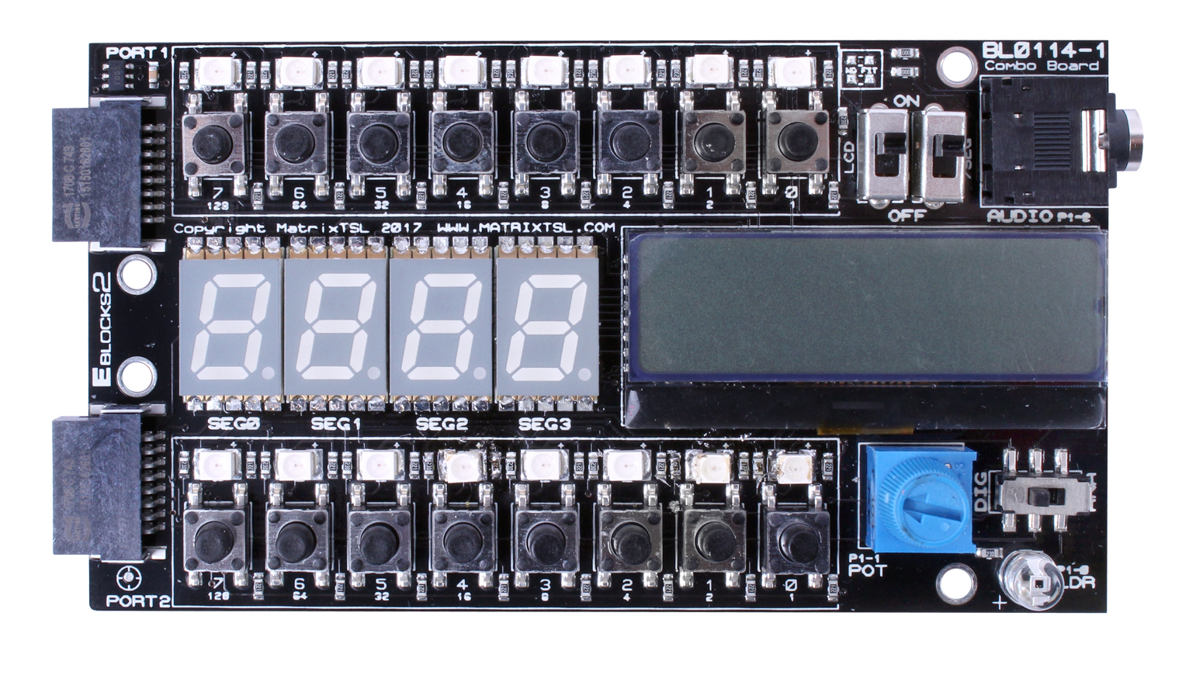
Hardware details
Combo board:
16 x push to make switches
16 LEDs
Quad 7-segment display
LCD display
Audio out jack
Potentiometer
Light sensor
A very flexible board.
Hardware circuit and function is controlled by switches – needs more care
Many devices on one pin – so a more complex circuit

Slide 24
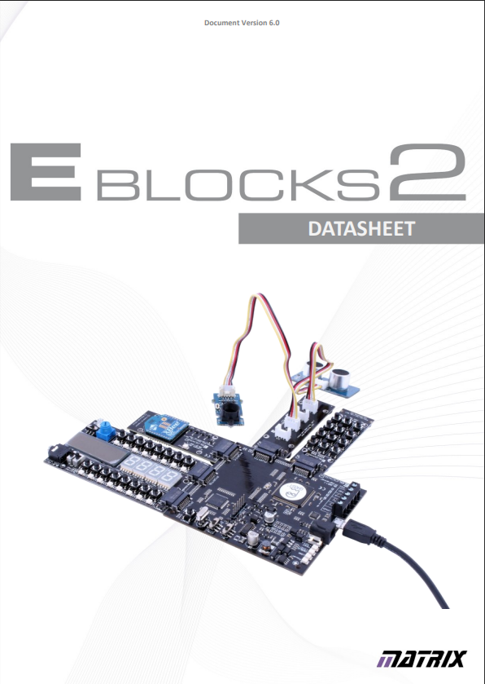
Hardware datasheet
3
All the circuits for all the boards can be found in the E-blocks 3 datasheet which you can find here: https://www.matrixtsl.com/eblocks/

Slide 25
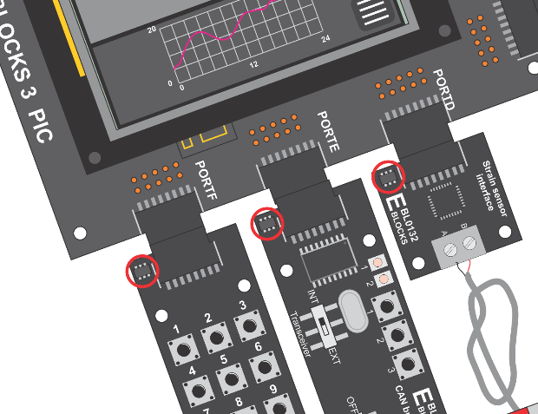
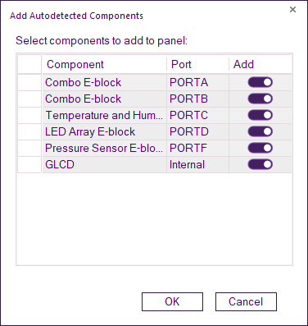
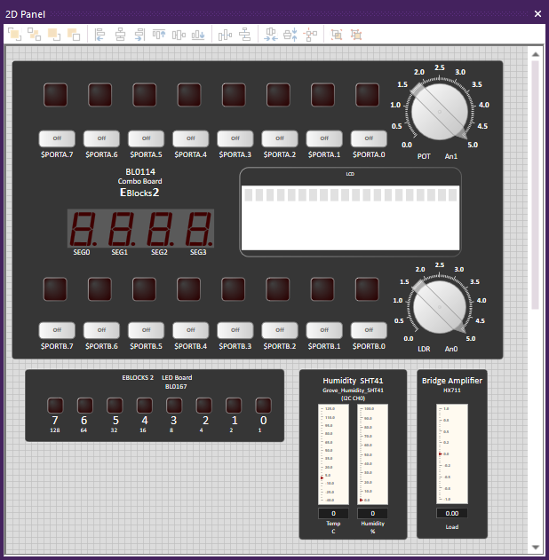
Auto ID feature
Every E-blocks downstream board has a small microcontroller on it
When you load Flowcode the software interrogates the hardware to find out what is connected and it sets the software up for you.

Slide 26
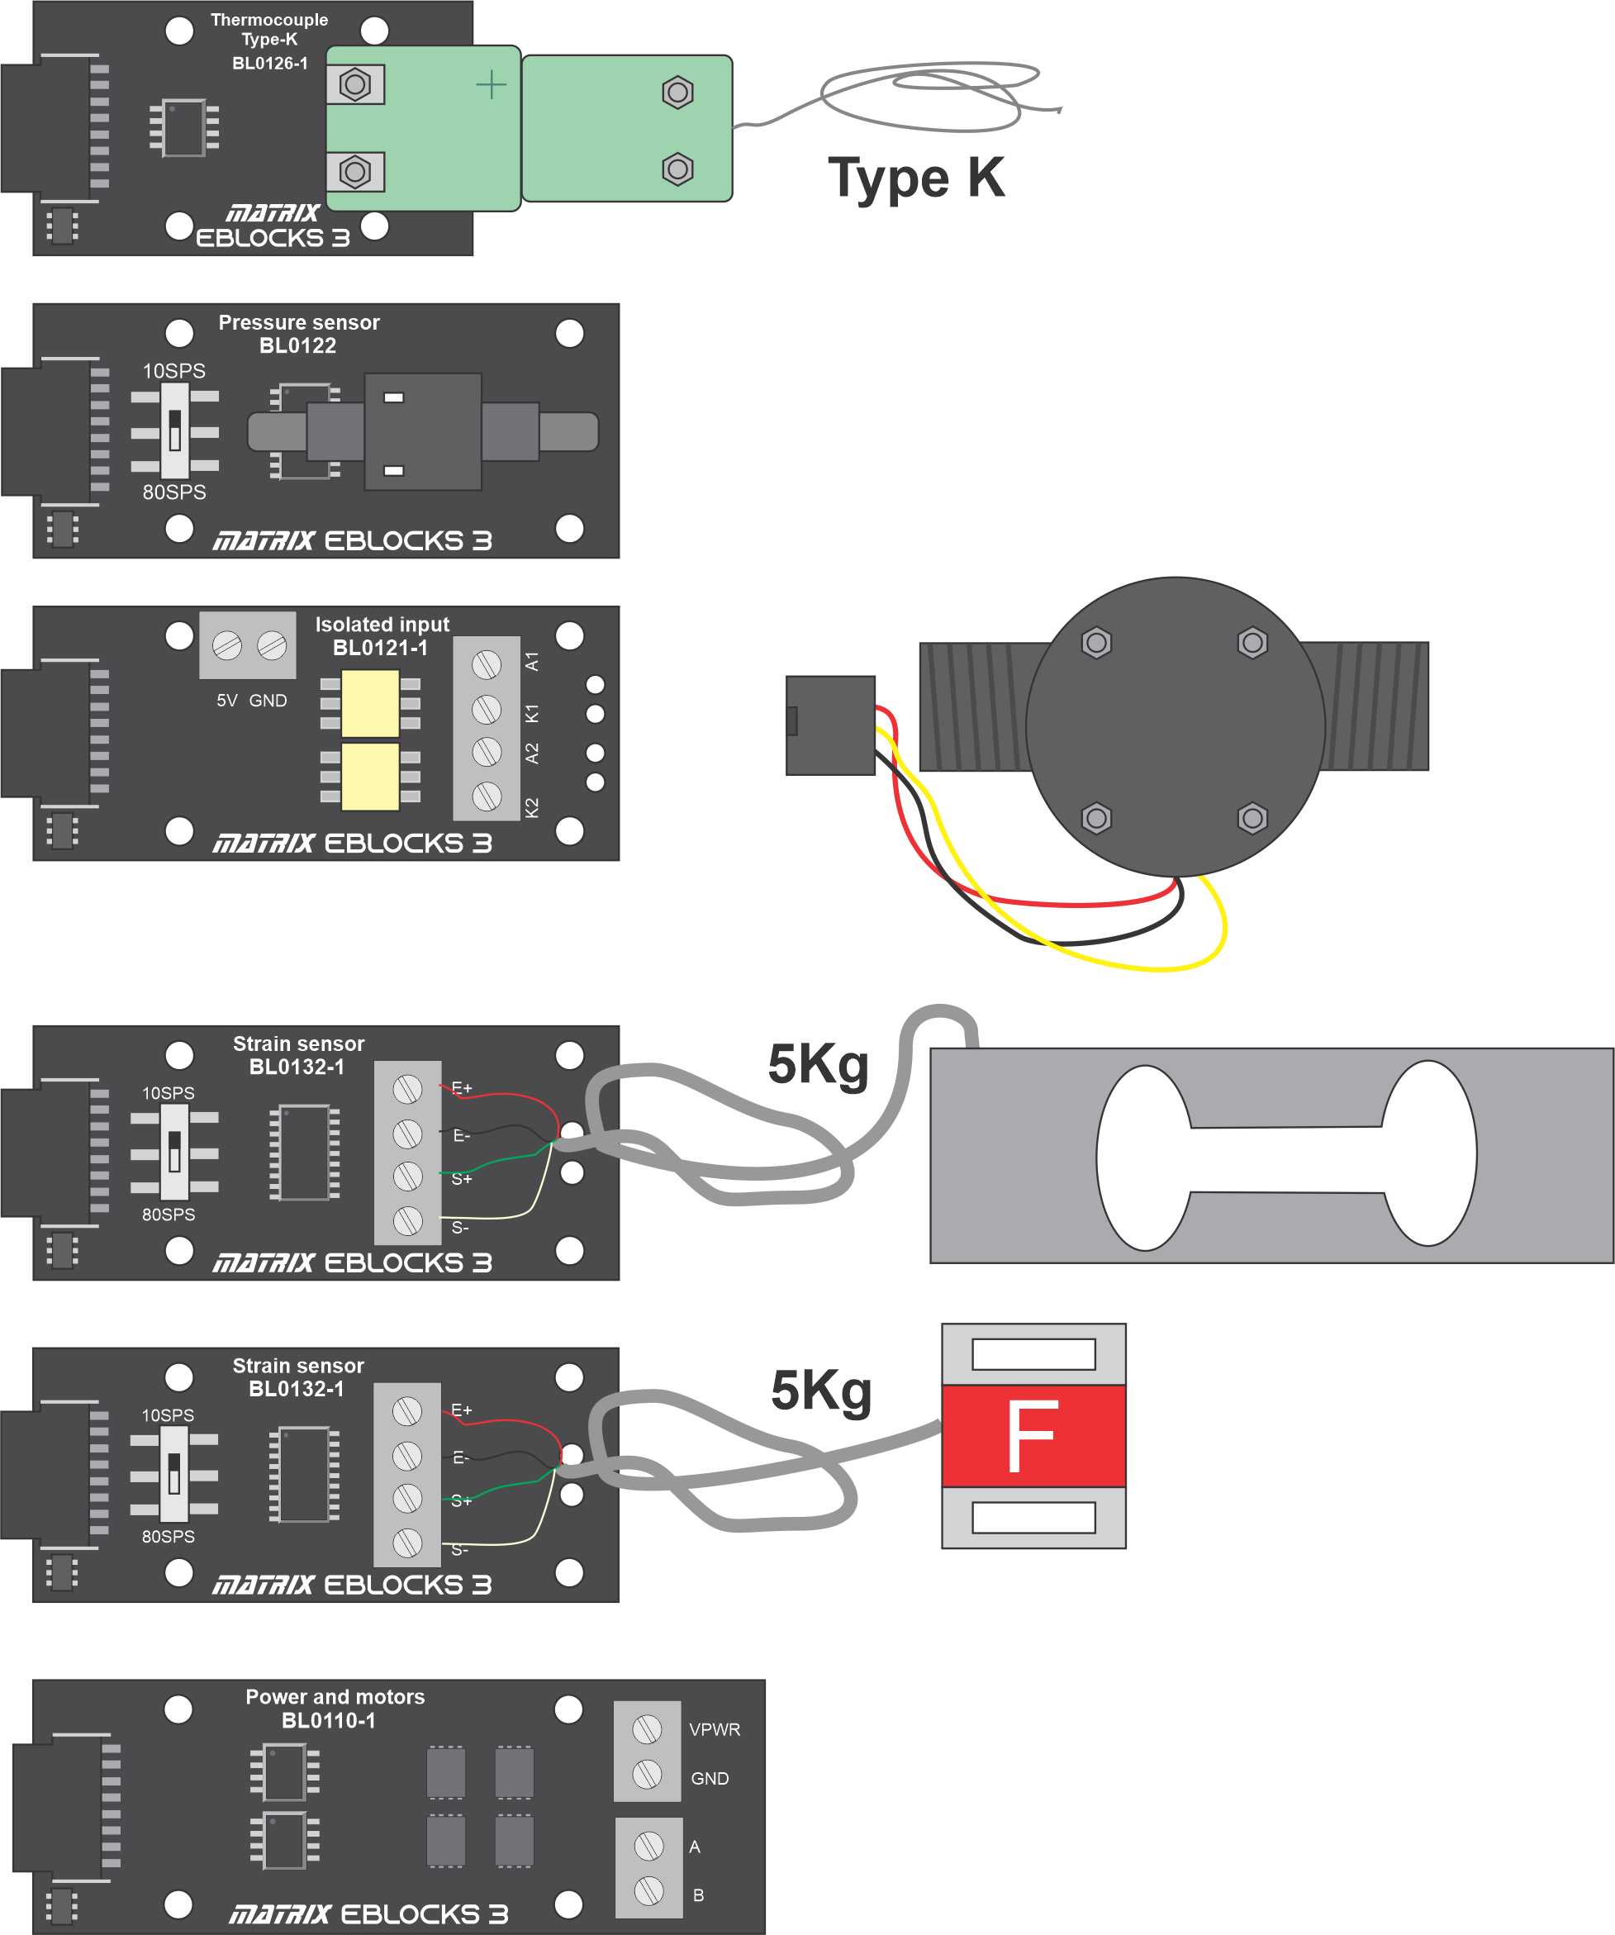
Engineering sensor add-ons
More complex projects need additional sensors
Type K thermocouple interface
Pressure sensor
Flow sensor
Compressive strain sensor
Tensile strain sensor
All these engineering sensor boards have worked examples embedded within Flowcode.
The Power board – 40V, 10A allows you to power any actuators that you might want to go in your kit – heaters, motors, pumps etc.

Slide 27
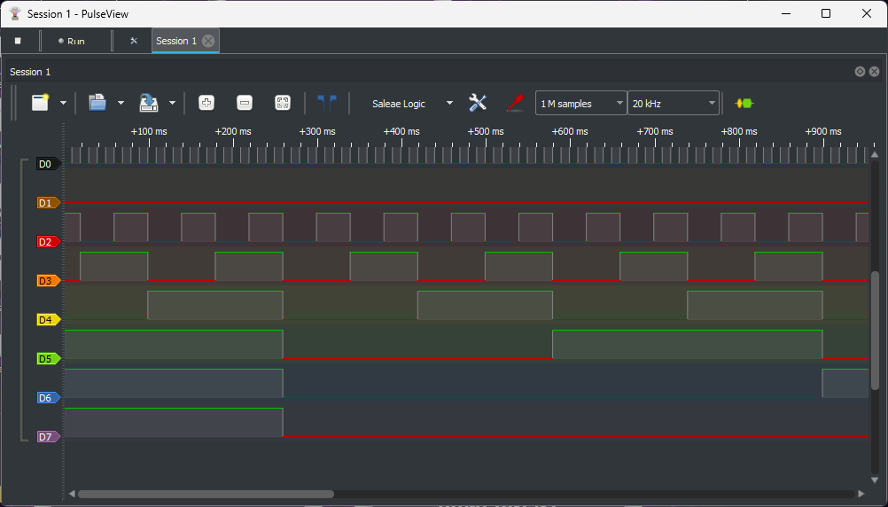
Logic analyser
8 channel
Signal decoding – I2C, SPI, etc
Connects to E-blocks port IDC connector
Free PulseView software
A great alternative way of looking at time-varying signals in microcontroller systems

Slide 28
Assessment and grading
Workflow in each curriculum pack:
Worksheet 1 and Challenge 1
Worksheet 2 and Challenge 2
Etc.
Home work assignments
Assessment projects
Test

Slide 29
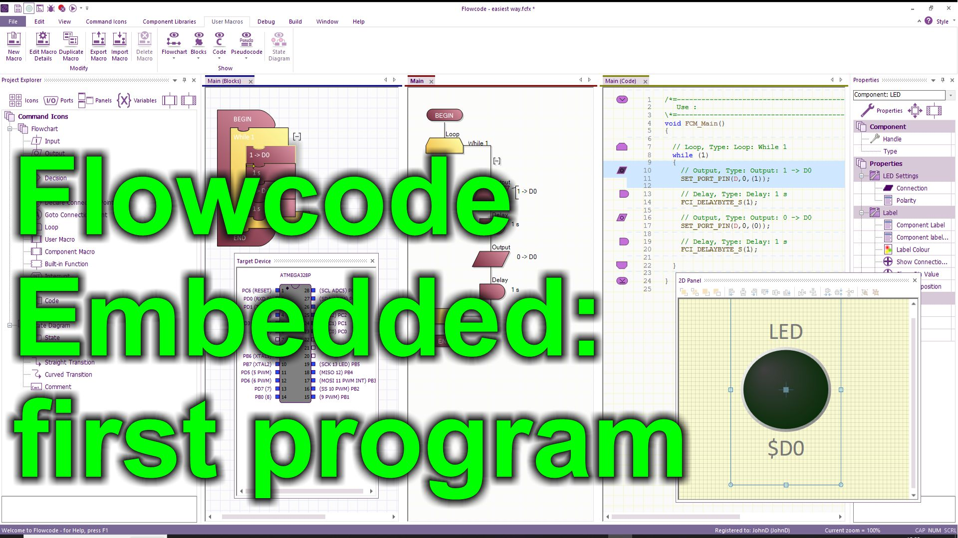
Demonstration
Next we will demonstrate the hardware and the software working
There is a video of this on the Flowcode YouTube site.

